Slide 1
Module 5: Numerical Examples in MATLAB

Slide 2
Outline of the Substructuring Exercises
A
+
B
=
C
Beam A & Beam B subsystems combine into Beam C
Truth Answer formed by directly superimposing matrices
Substructuring Assemblies:
Physical Substructuring with M, C & K of the beams
LM-FBS assembly of subsystem FRFs
Primal CMS assembly of A and B via modal basis
What are some errors that can come in?
LM-FBS: Noise in the FRFs
CMS: Modal Truncation

Slide 3
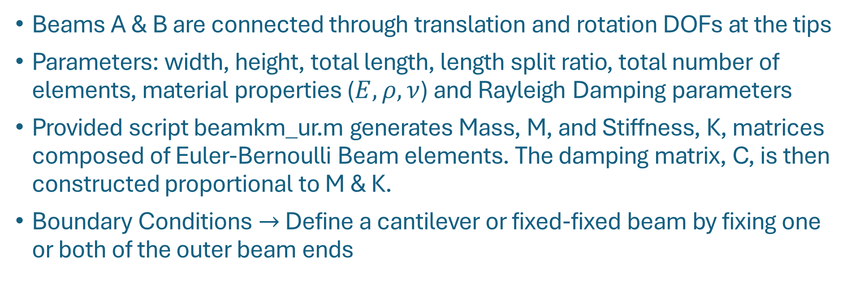
Section 1 & 2 : Beam Subsystems A & B
A
B
C
+
=
A
B
Beams A & B are connected through translation and rotation DOFs at the tips
Parameters: width, height, total length, length split ratio, total number of elements, material properties ($E, ρ, ν$) and Rayleigh Damping parameters
Provided script beamkm_ur.m generates Mass, M, and Stiffness, K, matrices composed of Euler-Bernoulli Beam elements. The damping matrix, C, is then constructed proportional to M & K.
Boundary Conditions $→$ Define a cantilever or fixed-fixed beam by fixing one or both of the outer beam ends
Notes:
A uniform small stiffness is added to each DOF to be a soft BC and slightly raise RBM above 0 Hz. This can help with avoiding inconsistencies with near-zero frequencies.

Slide 4






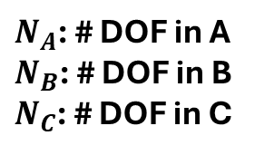








Section 1 & 2 : Truth Assembly By Superimposing Matrices
$$N_{C}=N_{A}+N_{B}−2$$
$N_{A}$: # DOF in A
$N_{B}$: # DOF in B
$N_{C}$: # DOF in C
$$M_{A}$$
Same procedure for $M, C \& K$
$$N_{A}$$
Mass Matrix: $M_{A}$
$$N_{B}$$
Mass Matrix: $M_{B}$
$$N_{C}$$
$$M_{C}$$
$$=$$
$$M_{B}$$
$$N_{A}$$
$$+$$
$$N_{B}$$

Slide 5
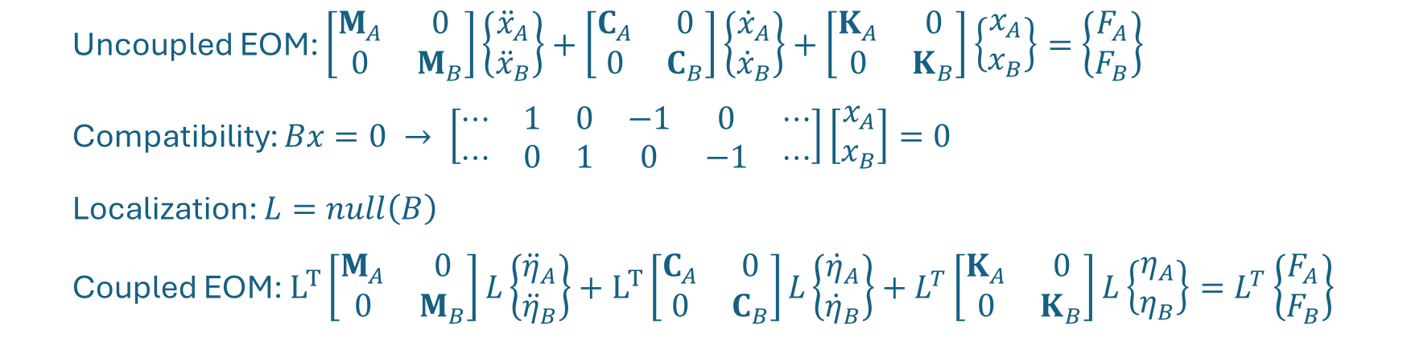
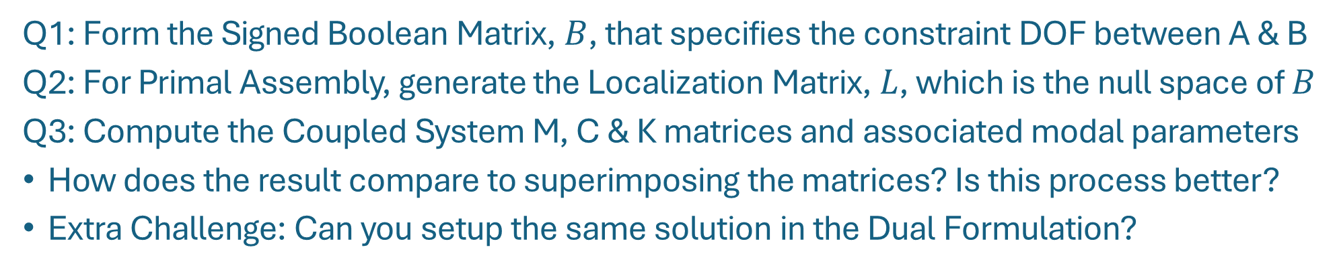
Section 3: Physical Substructuring
A
+
B
=
C
Q1: Form the Signed Boolean Matrix, $B$, that specifies the constraint DOF between A & B
Q2: For Primal Assembly, generate the Localization Matrix, $L$, which is the null space of $B$
Q3: Compute the Coupled System M, C & K matrices and associated modal parameters
How does the result compare to superimposing the matrices? Is this process better?
Extra Challenge: Can you setup the same solution in the Dual Formulation?
Equations:
Uncoupled EOM: $\left[\begin{matrix}M_{A} & 0 \\ 0 & M_{B}\end{matrix}\right]\left\{\begin{matrix}{\ddot{x}}_{A} \\ {\ddot{x}}_{B}\end{matrix}\right\}+\left[\begin{matrix}C_{A} & 0 \\ 0 & C_{B}\end{matrix}\right]\left\{\begin{matrix}{\dot{x}}_{A} \\ {\dot{x}}_{B}\end{matrix}\right\}+\left[\begin{matrix}K_{A} & 0 \\ 0 & K_{B}\end{matrix}\right]\left\{\begin{matrix}x_{A} \\ x_{B}\end{matrix}\right\}=\left\{\begin{matrix}F_{A} \\ F_{B}\end{matrix}\right\}$
Compatibility: $Bx=0 → \left[\begin{matrix}⋯ & 1 & 0 & −1 & 0 & ⋯ \\ ⋯ & 0 & 1 & 0 & −1 & ⋯\end{matrix}\right]\left[\begin{matrix}x_{A} \\ x_{B}\end{matrix}\right]=0$
Localization: $L=null\left(B\right)$
Coupled EOM: $L^{T}\left[\begin{matrix}M_{A} & 0 \\ 0 & M_{B}\end{matrix}\right]L\left\{\begin{matrix}{\ddot{η}}_{A} \\ {\ddot{η}}_{B}\end{matrix}\right\}+L^{T}\left[\begin{matrix}C_{A} & 0 \\ 0 & C_{B}\end{matrix}\right]L\left\{\begin{matrix}{\dot{η}}_{A} \\ {\dot{η}}_{B}\end{matrix}\right\}+L^{T}\left[\begin{matrix}K_{A} & 0 \\ 0 & K_{B}\end{matrix}\right]L\left\{\begin{matrix}η_{A} \\ η_{B}\end{matrix}\right\}=L^{T}\left\{\begin{matrix}F_{A} \\ F_{B}\end{matrix}\right\}$

Slide 6
Physical Substructuring Results & Takeaways
Results should be exactly the same as the Truth setup.
Superimposing is straightforward, but the substructuring framework is more general

Slide 7
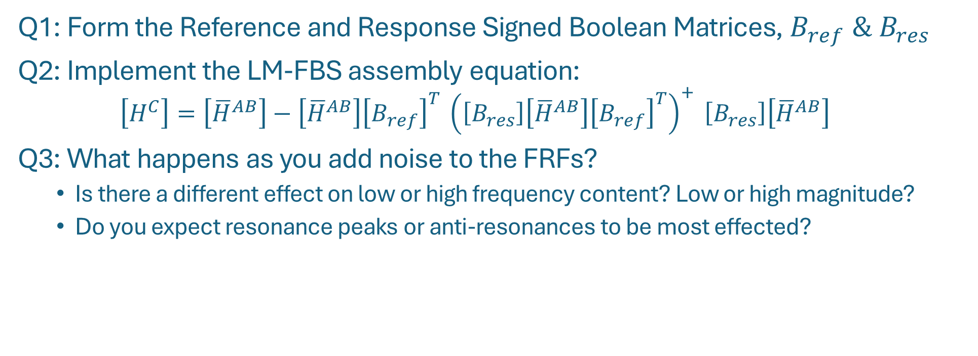
Section 4: Frequency Based Substructuring
A
+
B
=
C
Q1: Form the Reference and Response Signed Boolean Matrices, $B_{ref} \& B_{res}$
Q2: Implement the LM-FBS assembly equation:
$$\left[H^{C}\right]=\left[{\overline{H}}^{AB}\right]−\left[{\overline{H}}^{AB}\right]{\left[B_{ref}\right]}^{T} {\left(\left[B_{res}\right]\left[{\overline{H}}^{AB}\right]{\left[B_{ref}\right]}^{T}\right)}^{+} \left[B_{res}\right]\left[{\overline{H}}^{AB}\right]$$
Q3: What happens as you add noise to the FRFs?
Is there a different effect on low or high frequency content? Low or high magnitude?
Do you expect resonance peaks or anti-resonances to be most effected?

Slide 8
FBS Results and Takeaways
Noise and uncertainty in the FRFs can significantly deteriorate the results. This is a major concern when working with experimental FRFs.

Slide 9
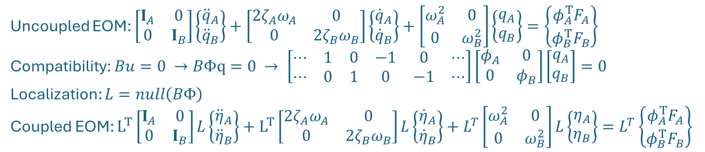
Section 5: Component Mode Synthesis
A
+
B
=
C
Q1,2,3: Compile the modal system matrices and construct the modal constraint matrix
Hint: the process is very similar to what you just did for the physical substructuring case
Compute the assembled system modal parameters
How does Modal Truncation affect the result?
Reduce the bandwidth of the modes in Beam A & Beam B
Change the position of the beam split and see effect on the resultant mode shapes
Uncoupled EOM: $\left[\begin{matrix}I_{A} & 0 \\ 0 & I_{B}\end{matrix}\right]\left\{\begin{matrix}{\ddot{q}}_{A} \\ {\ddot{q}}_{B}\end{matrix}\right\}+\left[\begin{matrix}2ζ_{A}ω_{A} & 0 \\ 0 & 2ζ_{B}ω_{B}\end{matrix}\right]\left\{\begin{matrix}{\dot{q}}_{A} \\ {\dot{q}}_{B}\end{matrix}\right\}+\left[\begin{matrix}ω_{A}^{2} & 0 \\ 0 & ω_{B}^{2}\end{matrix}\right]\left\{\begin{matrix}q_{A} \\ q_{B}\end{matrix}\right\}=\left\{\begin{matrix}φ_{A}^{T}F_{A} \\ φ_{B}^{T}F_{B}\end{matrix}\right\}$
Compatibility: $Bu=0 →BΦq=0 → \left[\begin{matrix}⋯ & 1 & 0 & −1 & 0 & ⋯ \\ ⋯ & 0 & 1 & 0 & −1 & ⋯\end{matrix}\right]\left[\begin{matrix}φ_{A} & 0 \\ 0 & φ_{B}\end{matrix}\right]\left[\begin{matrix}q_{A} \\ q_{B}\end{matrix}\right]=0$
Localization: $L=null\left(BΦ\right)$
Coupled EOM: $L^{T}\left[\begin{matrix}I_{A} & 0 \\ 0 & I_{B}\end{matrix}\right]L\left\{\begin{matrix}{\ddot{η}}_{A} \\ {\ddot{η}}_{B}\end{matrix}\right\}+L^{T}\left[\begin{matrix}2ζ_{A}ω_{A} & 0 \\ 0 & 2ζ_{B}ω_{B}\end{matrix}\right]L\left\{\begin{matrix}{\dot{η}}_{A} \\ {\dot{η}}_{B}\end{matrix}\right\}+L^{T}\left[\begin{matrix}ω_{A}^{2} & 0 \\ 0 & ω_{B}^{2}\end{matrix}\right]L\left\{\begin{matrix}η_{A} \\ η_{B}\end{matrix}\right\}=L^{T}\left\{\begin{matrix}φ_{A}^{T}F_{A} \\ φ_{B}^{T}F_{B}\end{matrix}\right\}$
Equations:

Slide 10
CMS Results and Takeaways
How Modal Truncation affects the resultant model is not obvious and depends on exactly what modes are involved and where the constraints are.
Mode 1 Error:
Frequency: 1%, Damping: -1%
Notes:
17.9768299067246 18.1491193846868 0.958397441907769
103.347962855095 118.527258027761 14.6875610832779
288.754991882320 364.463065456242 26.2187929913872
565.712423282355 580.065152782729 2.53710700166296
0.00568562820926678 0.00563504992501362 -0.889581280934195
0.00198127186630458 0.00200887165335677 1.39303381436830
0.00320184581946280 0.00388020483260246 21.1864983946500
0.00577613118011763 0.00591390688699863 2.38525931258701

Slide 11
CMS Results and Takeaways
How Modal Truncation affects the resultant model is not obvious and depends on exactly what modes are involved and where the constraints are.
Mode 2 Error:
Frequency: 14%, Damping: 1.4%
Notes:
17.9768299067246 18.1491193846868 0.958397441907769
103.347962855095 118.527258027761 14.6875610832779
288.754991882320 364.463065456242 26.2187929913872
565.712423282355 580.065152782729 2.53710700166296

Slide 12
CMS Results and Takeaways
How Modal Truncation affects the resultant model is not obvious and depends on exactly what modes are involved and where the constraints are.
Mode 3 Error:
Frequency: 26%, Damping: 21%
Notes:
17.9768299067246 18.1491193846868 0.958397441907769
103.347962855095 118.527258027761 14.6875610832779
288.754991882320 364.463065456242 26.2187929913872
565.712423282355 580.065152782729 2.53710700166296

Slide 13
CMS Results and Takeaways
How Modal Truncation affects the resultant model is not obvious and depends on exactly what modes are involved and where the constraints are.
?
Mode 4 Error:
Frequency: 2.5%, Damping: 2.4%
Notes:
17.9768299067246 18.1491193846868 0.958397441907769
103.347962855095 118.527258027761 14.6875610832779
288.754991882320 364.463065456242 26.2187929913872
565.712423282355 580.065152782729 2.53710700166296

Slide 14
CMS Results and Takeaways
How Modal Truncation affects the resultant model is not obvious and depends on exactly what modes are involved and where the constraints are.
In this scenario, a lot of subsystem modes are needed to correctly capture the curvature seen in the truth beam modes. Truncating the modes yields a connection that is too stiff
Notes:
17.9768299067246 18.1491193846855 0.958397441900635
103.347962855095 118.527258027761 14.6875610832778
288.754991882320 364.463065456242 26.2187929913871
565.712423282355 580.065152782731 2.53710700166326

Slide 15
Next Up – Experimental Considerations!

